Slide 1
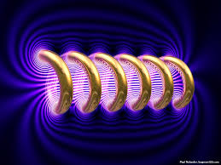
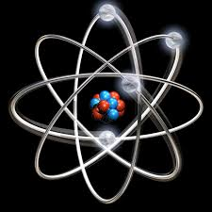

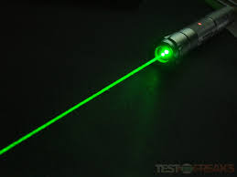
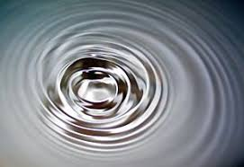
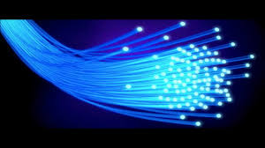
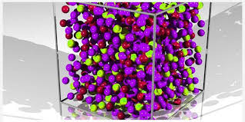
Engineering Physics
PHY-109
LASER-5
ELECTROMAGNETIC THEORY
QUANTUM MECHANICS
LASER
WAVES
Dr. Vishal Thakur
Department of Physics
Lovely Professional University
Phagwara, Punjab-144411
SOLID STATE PHYSICS
FIBER OPTICS

Slide 2
Syllabus
Fundamentals of laser- energy levels in atoms
Radiation matter interaction, Absorption of light
Spontaneous emission of light, stimulated emission of light
Population of energy levels, Einstein A and B coefficients
Metastable state, population inversion, lasing action
Properties of laser, resonant cavity, excitation mechanisms
Nd - YAG, He-Ne Laser, Semiconductor Laser
Applications of laser in engineering, holography.

Slide 3
Advantages and disadvantages of lasers
 | Ruby Laser | Nd-YAG Laser | He-Ne Laser | Semiconductor Laser
Advantages
1 | Easy to construct and operate, hence called practical laser | Easy to construct and operate, | Easy to construct and operate, | Easy in operation
2 | A Very strong and intense beam of power 10000 Watt or 10kWatts is produced. | By using Q-swithing, a laser beam pulse frequency and shape can be tailored. May produce a high energy beam up to 1 Joule. | Continuous beam | Long life, highly monochromatic, tunable and continuous beam
3 | May produce a laser beam of 1mm to 25mm in diameter | A short pulse period down to 10ns may be obtained. | Exceptionally monochromatic beam with high operation duration (10000hrs) | Excellent efficiency with very high operation duration (20000Hrs.)
Disadvantages
1 | Its laser beam is only pulse like and its operation duration is very less (few Hrs.) | Slower production for thicker materials, Lower absorption of radiation of lighter materials. | It has very low power about 0.5-5mWatt. | It has very low power about 200mWatt.

Slide 4
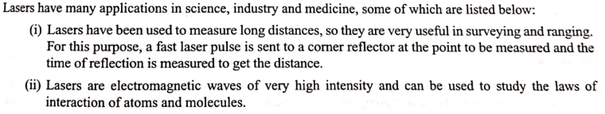
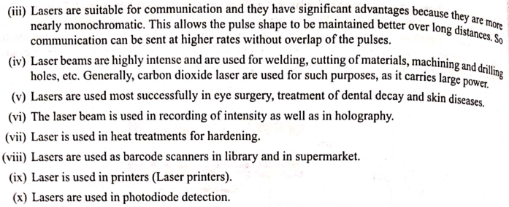
Applications of Lasers

Slide 5
Simple photography
Two dimensional image of the object is formed
First Negative is obtained by developing the film
Then Positive is obtained through the printing
This positive print is a two dimensional record of light intensity received from the object
It contains information about the SQUARE OF THE AMPLITUDE of the light wave that produced the image.
But the information about the phase of the wave is not recorded and is LOST.

Slide 6
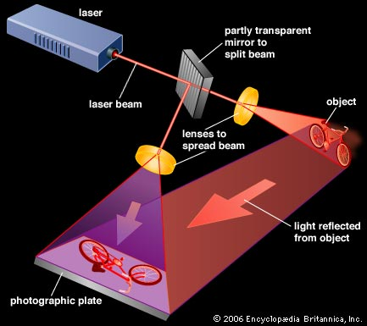
Holography
It is a technique of photography where the whole information of an object including its intensity and phase are recorded on a photographic film. It was invented by Danis Gabor in 1948. He obtained Nobel prize for the invention in 1971.
Holography= Holos (whole) + Grapho (to write)
It is based on the principle that when object wave or the reflected wave from any object and the reference wave interfere, then it records the complete detail of the object in 3 dimension.
These are of many types
Transmission hologram
Reflection hologram
White light hologram
Embossed hologram
Volume hologram
In 1948, Dennis Gabor gave this new technique of photographing the objects and is known as WAVE FRONT RECONSTRUCTION

Slide 7
Holography
Holography is a “LENSLESS PHOTOGRAPHY” in which image is captured as an interference pattern at the film without a lens.
A method of obtaining three-dimensional photographic images.
The records are called holograms.
It record both “INTENSITY as well as PHASE”
It is a TWO STEP process
First step is the Construction of hologram: where the object is transformed into a photographic record
Second Step is the Reconstruction: in which the hologram is transformed into the image

Slide 9
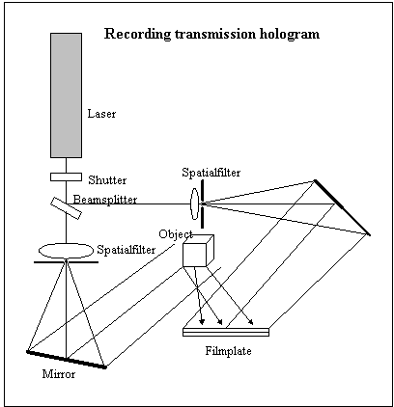
Holography: Working: Recording
Recording process
In order to make hologram two coherent light waves are required.
The first one is called the object wave and the other is called the reference wave.
The object wave is reflected from the object and carries all the information about the object.
The reference wave is a plane wave without any information.
These two waves when allowed to fall on a photographic plate interferes with each other and the interference pattern is recorded in the photographic film.
For obtaining the stable interference patterns absolutely stable conditions are required during the exposure of the film.
Each part of the hologram receives light from every part of the object and hence even if the hologram is cut into pieces, each part is capable of reconstructing the whole image.

Slide 10
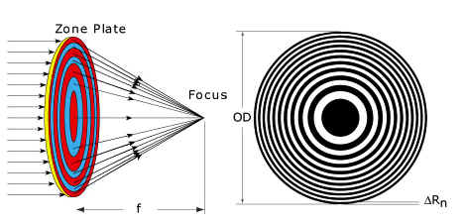
Diffraction Zone Plate
A zone plate is a device used to focus light or other things exhibiting wave character. Unlike lenses or curved mirrors however, zone plates use diffraction instead of refraction or reflection. They are sometimes called Fresnel zone plates. A zone plate consists of a set of radially symmetric rings, known as Fresnel zones, which alternate between opaque and transparent. Light hitting the zone plate will diffract around the opaque zones. The zones can be spaced so that the diffracted light constructively interferes at the desired focus, creating an image there.

Slide 11
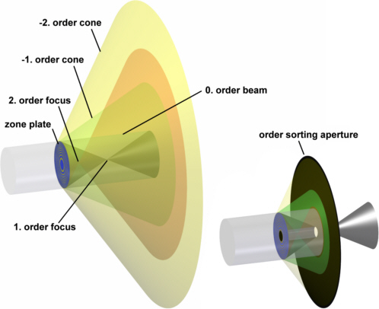
Diffraction Zone Plate
A grating mostly has more than one diffraction order. In a Fresnel zone plate this leads to more than one focus point. The negative diffraction orders even result in diverging beams, in other words: zone plates also behave like a dispersive lens with virtual focus points. When a zone plate is used as focusing lens, normally only the first diffraction order is used and all other orders have to be blocked by a suitable aperture.
http://www.x-ray-optics.de/index.php/en/types-of-optics/diffracting-optics/fresnel-zone-plates#Fresnel_zone_plates

Slide 12
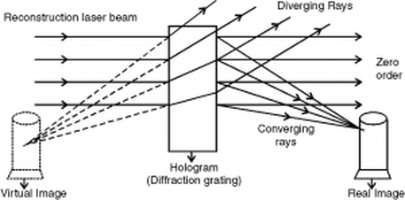
Holography: Working: Reconstruction
Reconstruction process
The reconstruction is based on the principle of diffraction. The hologram is illumined by collimated laser beam.
One set of diffracted beams emerging from the hologram, appears to diverge from an apparent object when projected backward. This constructs the virtual image which is observed by looking through the hologram.
The other beam produces a real image which can be recorded on a photographic plate.
By developing the hologram and placing it in its original position in the reference beam as during recording, we can reconstruct the image. Both real and virtual image are formed in the reconstruction process.
As we look along the reconstructed object wave, we see a replica of the object.

Slide 13
Holography: Requirements
There should not be any path difference between the object wave and the reference wave more than the coherence length.
Spatial coherence is important so that the reference wave and the scattered wave from different regions can interfere properly.
All recording instruments must be in a motionless condition.

